Slide 1

Your first paperless
wine event
EUREKA! The California Wine Discovery Tour 2023

Slide 2

2023 is a landmark year for sustainability in the wine industry
Sustainability is more important than ever
This is about nothing less than the future of our industry, and wine events can make a difference.
COVID drove digitalization in the wine industry
Over the past two years you became good at using digital technology to sell wine. More than 40% of Americans will scan QR codes this year.
There is a better way to do physical events
Physical events offer one of the most efficient ways to do business. But they can be even better when supported by technology.
Welcome to your first paperless wine event.

Slide 3


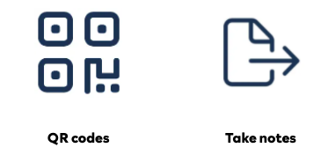
A revised strategy will ensure high energy at the event
Producers are grouped according to AVA
The large tasting room will have producers grouped by specific AVAs, creating a trip to wine country that ensures our guests ares exposed to the diversity of California wines.
Technology supports the tasting at every step of the way
We are using technology to ensure that producers and guests both get the most out of this new format. From online tour and tasting lists, QR codes at counters to jump to tasting pages, ability to take notes on mobile, upload and print later.

Slide 4
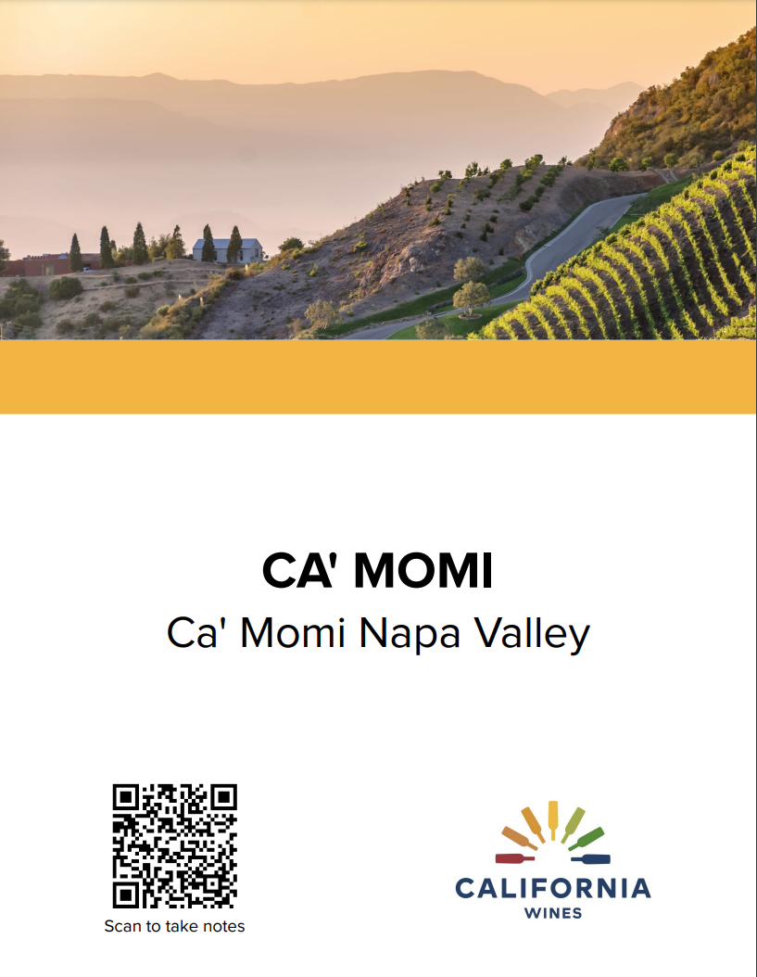
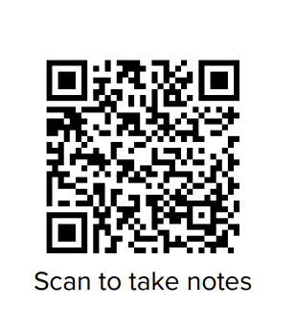
Catalogs will not be distributed.
How will it work?
Visitors build their tasting booklet at home
Visitors build their tasting booklet before coming to the show. This helps them ensure they know exactly which producers they want to taste. Guests can print their own personal itinerary or use the digital version.
QR codes on each stand show the wines
Each stand has a large sign with your name as well as QR code. Visitors scan the QR code to see which wines they bookmarked to taste.
Digital tasting notes!
Visitors can create tasting notes directly on their device. They can export their notes to PDF or Excel when they get home.
Tasting notes are private! No data is shared!

Slide 5
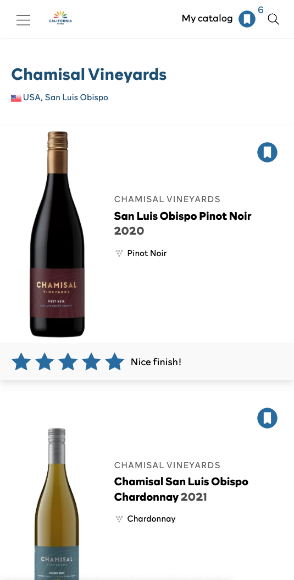
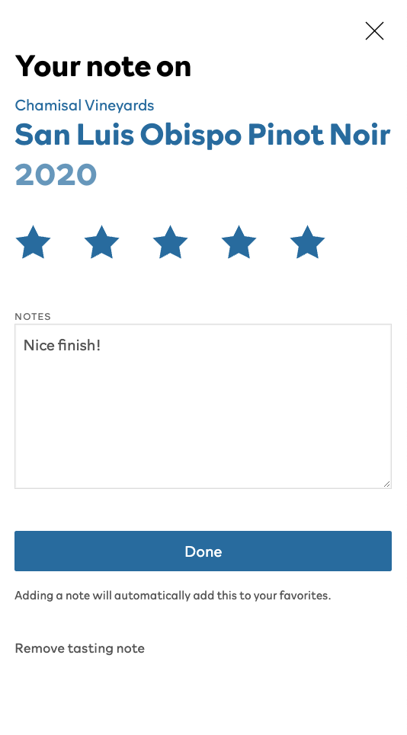
A note on tasting notes
5 point scale
Everyone has their own strategy to rate wines. Bottlebooks uses a simple 5-point scale to help visitors quickly rate the wines they tasted.
Digital tasting notes
More press and trade transfer their tasting notes into their computers after the event. Our directory saves them the effort to retype them.
Notes are private
Digital tasting notes are as private as paper tasting notes.

Slide 6
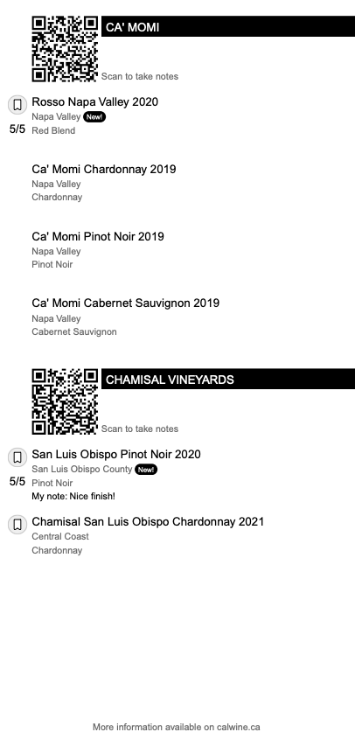
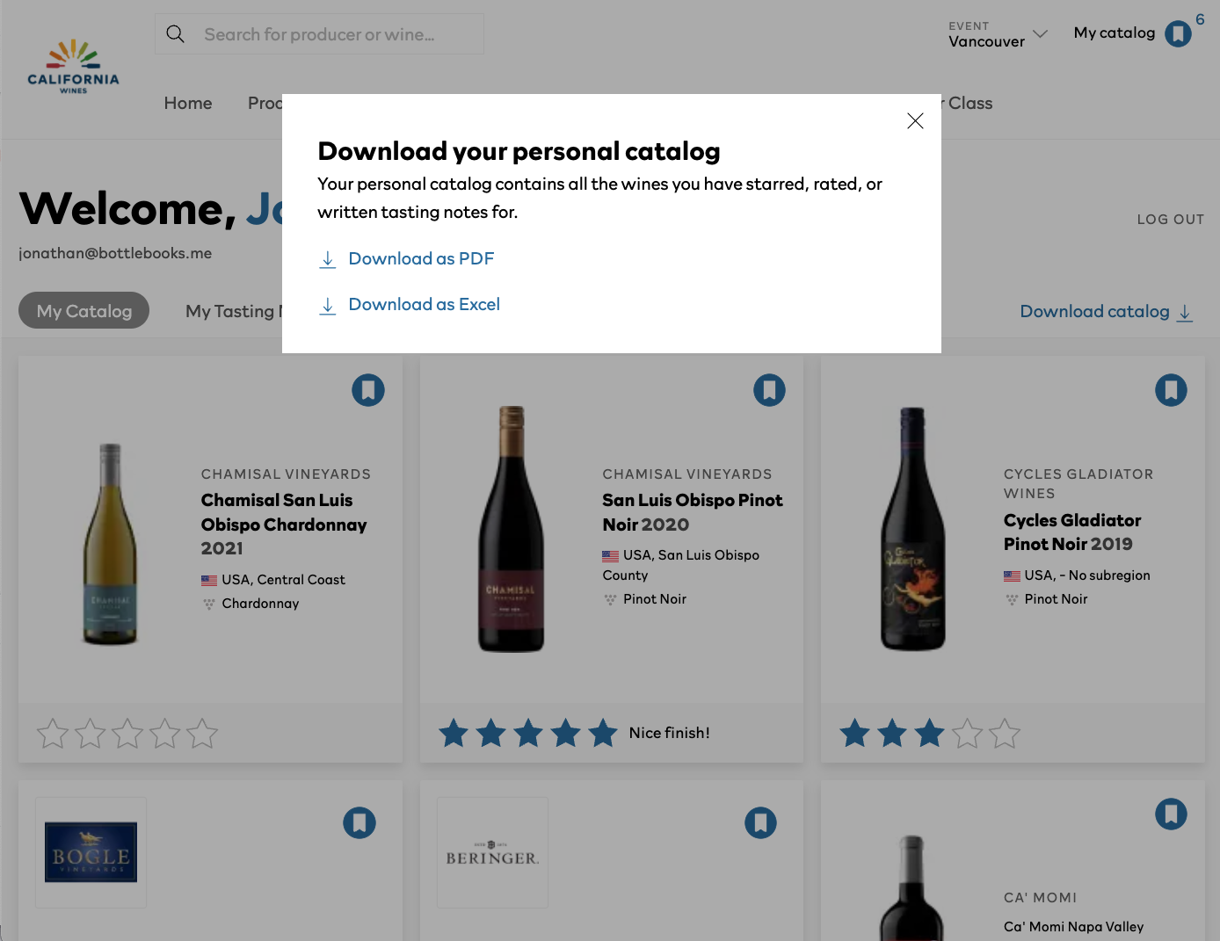
Visitors can print personalized tasting booklets at home
A print option for those who prefer
We will not be distributing catalogs. But visitors can print their personalized tasting booklets at home.
How is this sustainable?
Each tasting booklet is significantly smaller than our previous print catalogs because they contain only those wines on the visitors tasting list. It is not possible to print a complete catalog.

Slide 7
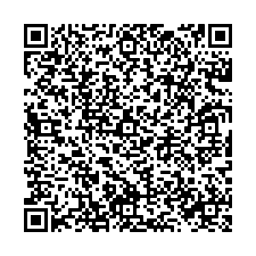
Attendee badges can be scanned - no more business cards
vCards are business cards encoded as QR codes.
New for 2023!
All attendees (producers and trade) will have vCards printed on their badges. vCards allow contact details to be added to your address book without manually re-typing business cards.
Ensure contact information is correct in Bottlebooks
Exhibitor badges will be printed based on the information entered into Bottlebooks. Please review this information for completeness.
JOHN SMITH
SOMMELIER
FANCY RESTAURANT

Slide 8
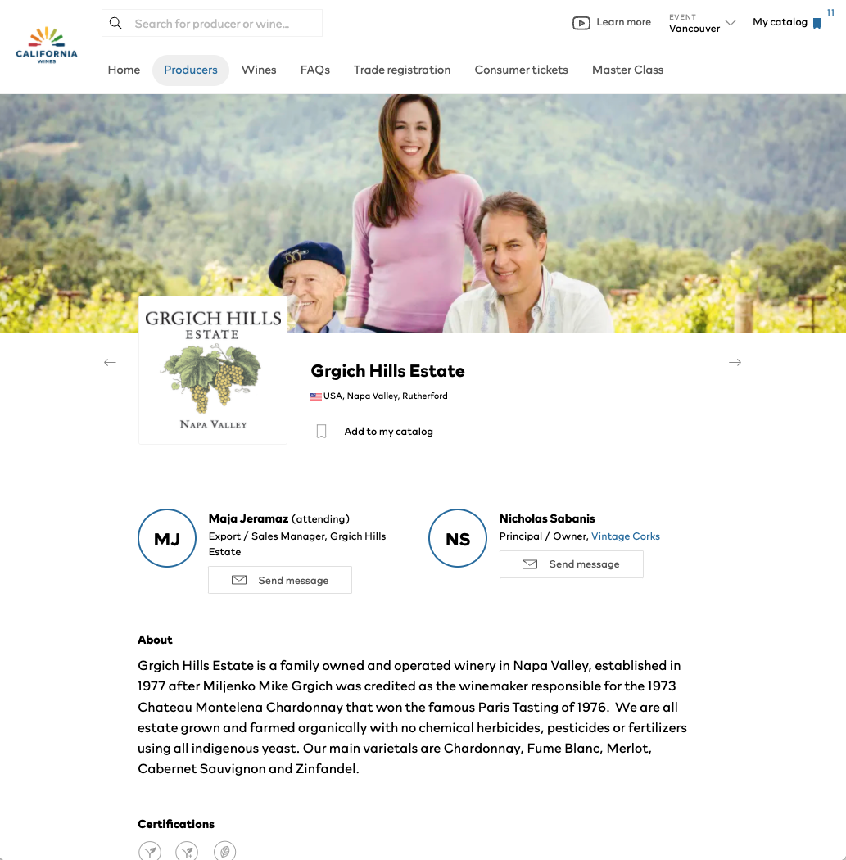
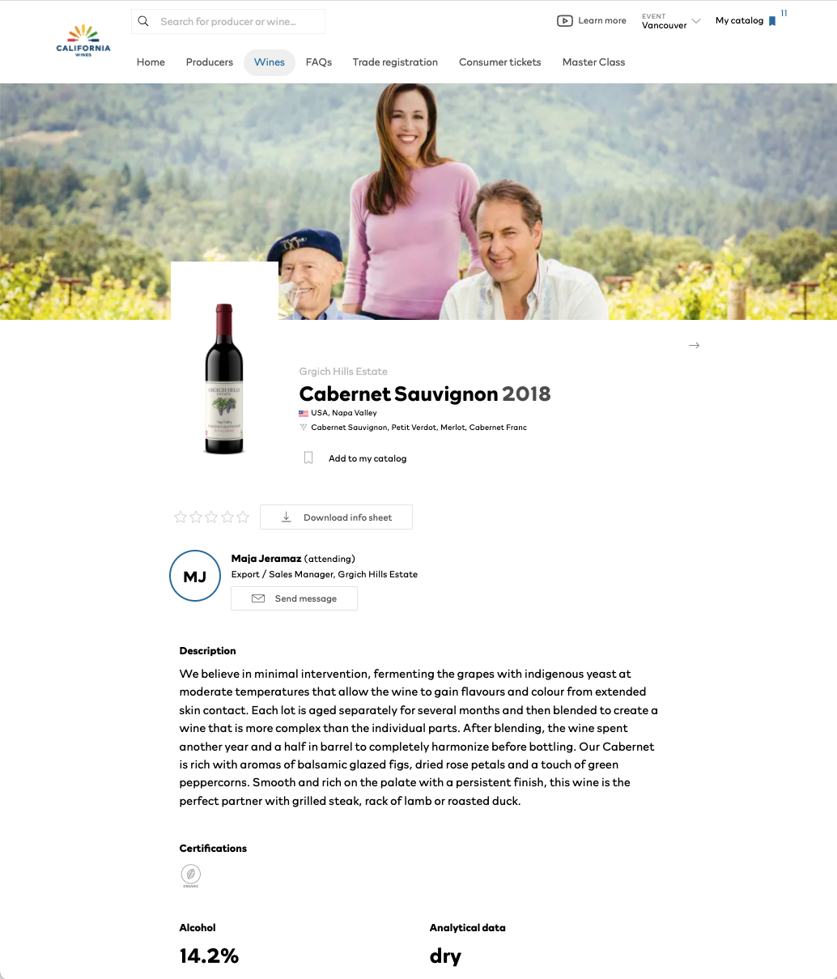
Ensure that your profile is complete
You are responsible for your profile
CWI is not reviewing or editing producer profile information. Information will be published on the website exactly how it is entered in Bottlebooks.
Check for spelling and completeness. Upload gallery images and videos for enhanced profiles.
Bottlebooks is open until March 24th for changes
Your registration has been marked as “in progress.” All producers are requested to return to Bottlebooks, review their information, and mark their registrations as complete.
Tip: Check your bottle shots, are any missing?
Does your profile photo work?

Slide 9
Summary
Tips & Tricks
No print catalogs - only digital and self-print
QR codes on your tables take visitors to your wines
Visitors encouraged to take digital tasting notes at the event
Scan badges to get contact information
Bottlebooks is open until March 24th for changes
Please review the website and send any suggestions to Bottlebooks (contact@bottlebooks.me).
This information only has to be updated in one registration
Winery profile
Wine product information
This information must be reviewed in each event:
Which wines you’re pouring
Contact information
  Agents should contact wineries for changes
Media
Profile pictures: high-res landscape
  Bottlebooks auto crops / centers for faces
Bottle images: jpg, png, tiff (no pdf)
Youtube videos (can add multiple)
Photo gallery

